Slide 1
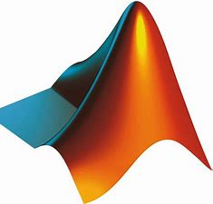
MATLAB PROJECT ON EDGE DETECTION

Slide 2
ACKNOWLEDGEMENT
We have taken efforts in this project. However, it would not have been possible without the kind support and help of many individuals. We would like to extend our sincere thanks to all of them. First and foremost, we would like to thank Prof. Ankur Gupta (Director) Model Institute of Engineering and Technology (MIET) Jammu, and Prof. (Dr.) Ashok Kumar Dean (Academics) and Head of Department.
As special gratitude we give to our mentor Mrs. Gurpreet and Shiveta Mam whose contribution in stimulating suggestions and encouragement which helped us to writing this report. Lastly, we would like to thank our respected parents who always encouraged us and taught us to think and workout innovatively whatsoever be the feel of life.

Slide 3
Our team members-
NAME ROLL NO.
Shriya Manhas 2020a3r009
Simran Choudhary 2020a3t016
Mehak 2020a3r007
Rupali Sharma 2020a3r012
Mitali Abrol 2020a3r010

Slide 4
CONTENT
Abstract
Introduction
Process
Code
Output
References

Slide 5
:
ABSTRACT
Edge detection is an image processing technique for finding the boundaries of objects within images. It works by detecting discontinuities in brightness. Edge detection is used for image segmentation and data extraction in areas such as image processing, computer vision, and machine vision.
Common edge detection algorithms include Sobel, Canny, Prewitt, Roberts, and fuzzy logic methods.

Slide 6
For edge detection in this project, we take the help of convolution: Convolution = I * m where I is the image, m is the mask and * is convolutional operator. To perform convolution on an image following steps are required:
Flip the mask horizontally and then vertically. This will result in 180-degree rotation of an image.
1. Slide the mask onto the image such that every pixel in the image coincides with the center of the mask atleast once.
2. Multiply the corresponding elements with the pixel values below it and then add them.
3.Repeat this procedure until all pixel values of the image have been calculated for updation.

Slide 7
INTRODUCTION:
Edge detection is an image processing technique for finding the boundaries of objects within images. It works by detecting discontinuities in brightness. Edge detection is used for image segmentation and data extraction in areas such as image processing, computer vision, and machine vision.
Approach :
For edge detection, we take the help of convolution: Convolution = I * m where I is the image, m is the mask and * is convolutional operator. To perform convolution on an image following steps are required:

Slide 8
Flip the mask horizontally and then vertically. This will result in 180-degree rotation of an image.
Slide the mask onto the image such that every pixel in the image coincides with the centre of the mask at least once.
Multiply the corresponding elements with the pixel values below it and then add them.
Repeat this procedure until all pixel values of the image have been calculated for updation.

Slide 9
Now, we will take 3×3 mask for the same.
3×3 Mask for vertical edges : [1, 0, -1; 1, 0, -1; 1, 0, -1]
3×3 Mask for horizontal edges : [1, 0, -1; 1, 0, -1; 1, 0, -1]
3×3 Mask for principal diagonal edges : [1, 0, -1; 1, 0, -1; 1, 0, -1]
3×3 Mask for secondary diagonal edges : [1, 0, -1; 1, 0, -1; 1, 0, -1]
We’ll find these edges separately and finally combine them using max function or mean function but max function is more accurate for this.
.

Slide 10
THE CODE:
I=double(imread('image.jpg'));
In=I;
mask1=[1, 0, -1;1, 0, -1;1, 0, -1];
mask2=[1, 1, 1;0, 0, 0;-1, -1, -1];
mask3=[0, -1, -1;1, 0, -1;1, 1, 0];
mask4=[1, 1, 0;1, 0, -1;0, -1, -1];
mask1=flipud(mask1);
mask1=fliplr(mask1);
mask2=flipud(mask2);
mask2=fliplr(mask2);
mask3=flipud(mask3);
mask3=fliplr(mask3);
mask4=flipud(mask4)

Slide 11
mask4=fliplr(mask4);
for i=2:size(I, 1)-1
for j=2:size(I, 2)-1
neighbour_matrix1=mask1.*In(i-1:i+1, j-1:j+1);
avg_value1=sum(neighbour_matrix1(:));
neighbour_matrix2=mask2.*In(i-1:i+1, j-1:j+1);
avg_value2=sum(neighbour_matrix2(:));
neighbour_matrix3=mask3.*In(i-1:i+1, j-1:j+1);
avg_value3=sum(neighbour_matrix3(:));

Slide 12
neighbour_matrix4=mask4.*In(i-1:i+1, j-1:j+1);
avg_value4=sum(neighbour_matrix4(:));
%using max function for detection of final edges
I(i, j)=max([avg_value1, avg_value2, avg_value3,
avg_value4]);
end
end
figure, imshow(uint8(I))

Slide 13
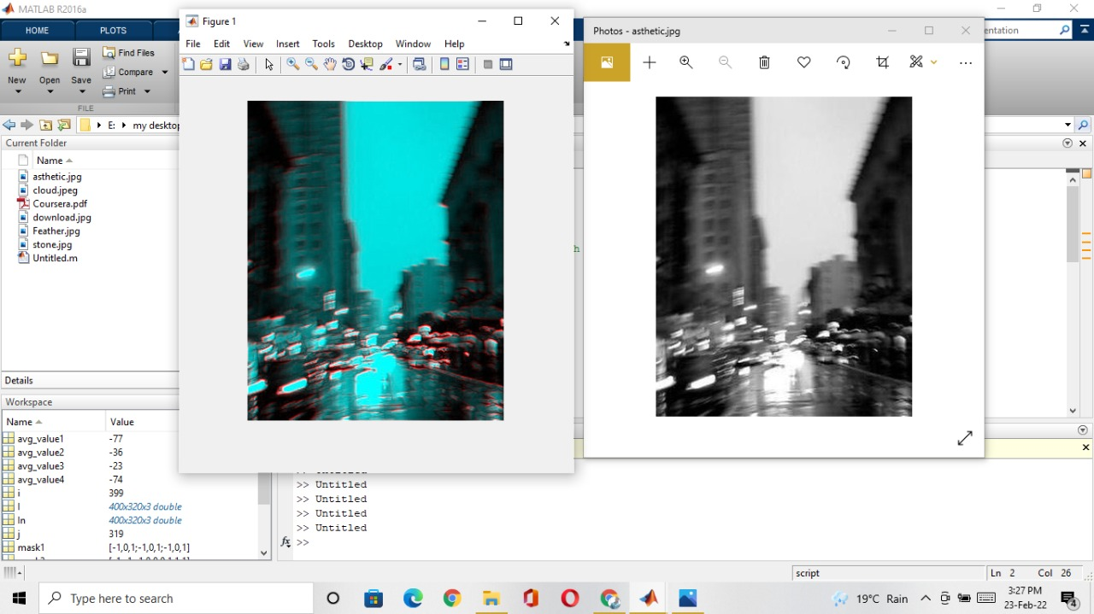

Slide 14
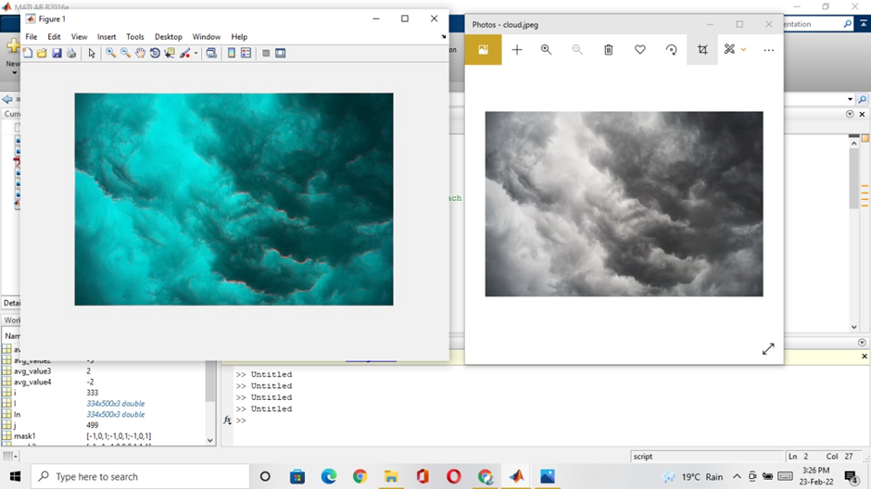

Slide 15
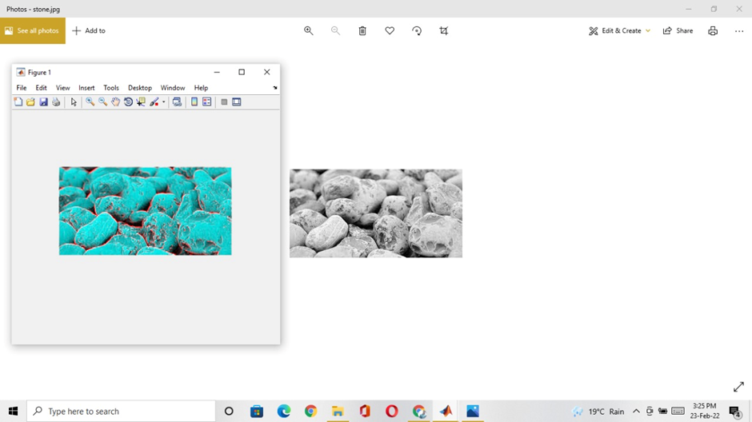
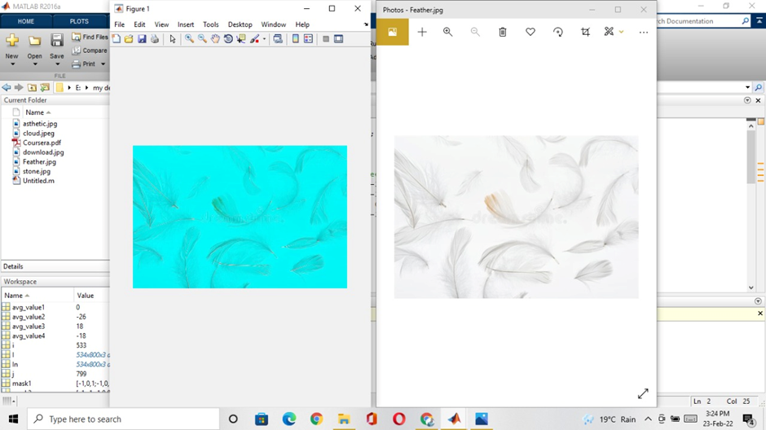

Slide 16
